Slide 1
Number System

Slide 2
The number system or the numeral system is the system of naming or representing numbers.
The value of any digit in a number can be determined by:
The digit
Its position in the number
The base of the number system

Slide 3
Types of Number Systems
There are various types of number systems in mathematics. The four most common number system types are:
Decimal number system (Base- 10)
Binary number system (Base- 2)
Octal number system (Base-8)
Hexadecimal number system (Base- 16)

Slide 4
Decimal Number System (Base 10 Number System)
The decimal number system has a base of 10 because it uses ten digits from 0 to 9.
In the decimal number system, the positions successive to the left of the decimal point represent units, tens, hundreds, thousands and so on.
Example:The decimal number 1457 consists of the digit 7 in the units position, 5 in the tens place, 4 in the hundreds position, and 1 in the thousands place whose value can be written as:

Slide 5
(1×10³) + (4×10²) + (5×10¹) + (7×10⁰)
(1×1000) + (4×100) + (5×10) + (7×1)
1000 + 400 + 50 + 7
1457

Slide 6
Binary Number System (Base 2 Number System)
The base 2 number system is also known as the Binary number system wherein, only two binary digits exist, i.e., 0 and 1.
We can convert any system into binary and vice versa.
Example
Write (14)₁₀ as a binary number.

Slide 7
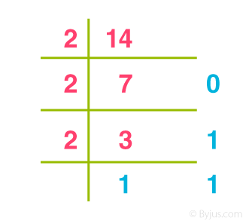
Solution
∴ (14)₁₀ = 1110₂

Slide 8
Octal Number System (Base 8 Number System)
In the octal number system, the base is 8 and it uses numbers from 0 to 7 to represent numbers.
Octal numbers are commonly used in computer applications.
Example: Convert 215₈ into decimal.
Solution:
215₈ = 2 × 8² + 1 × 8¹ + 5 × 8⁰
= 2 × 64 + 1 × 8 + 5 × 1
= 128 + 8 + 5
= 141₁₀

Slide 9
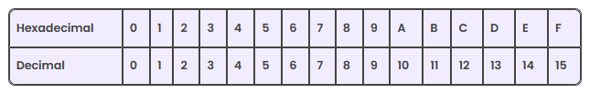
Hexadecimal Number System (Base 16 Number System)
In the hexadecimal system, numbers are written or represented with base 16.
In the hexadecimal system, the numbers are first represented just like in the decimal system, i.e. from 0 to 9. Then, the numbers are represented using the alphabet from A to F.

Slide 10
Number System Conversion
The number 349 in the binary number system is 101011101
The number 349 in the decimal number system is 349.
The number 349 in the octal number system is 535.
The number 349 in the hexadecimal number system is 15D

Slide 11
Example 1:
Convert (1056)₁₆ to an octal number.
Solution:
Given, 1056₁₆ is a hex number.First we need to convert the given hexadecimal number into decimal number
(1056)₁₆
= 1 × 16³ + 0 × 16² + 5 × 16¹ + 6 × 16^0
= 4096 + 0 + 80 + 6
= (4182)₁₀

Slide 12
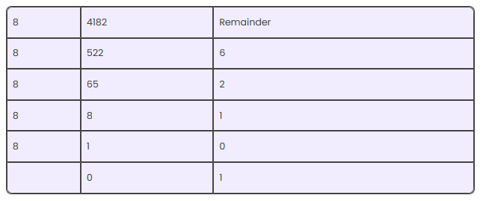
Now we will convert this decimal number to the required octal number by repetitively dividing by 8.

Slide 13
Therefore, taking the value of the remainder from bottom to top, we get;
(4182)₁₀ = (10126)₈
Therefore,
(1056)₁₆ = (10126)₈

Slide 14
Example 2:
Convert (1001001100)2 to a decimal number.
Convert hexadecimal 2C to decimal number.
Convert 10101₂ into an octal number.

